Slide 1
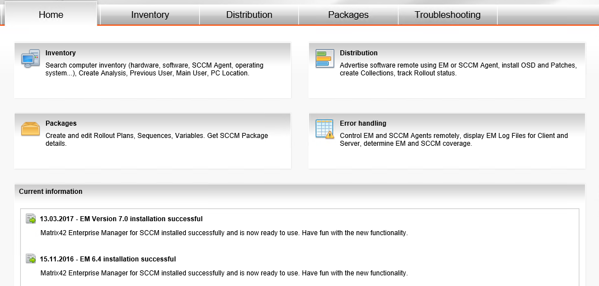
Matrix42 Enterprise Manager for SCCM Reduce your IT costs
David Koenig
www.expertslive.at
@davidkoenig09
Notes:
Introduction

Slide 2


Cost savings with EM
Cost optimization with EM can be done in 3 steps:
Make live easier for Central-, Onsite-, and Helpdesk Support
Optimize processes in your company
Reduce interruption for End-User
SCCM native
With EM

Slide 3
Examples for cost saving Helpdesk
~1 helpdesk engineer for every 1000 Client
In Munich a Support Engineer earns ~3.200€ p.m.
~ more than the half of every company has one escalation per year because of a huge number of unworked incidents
10 -> 4 minutes
20€ -> ~6€
5 -> 2 minutes
5€ -> ~3€
100
Volume
80
60
SCCM native
40
With EM
20
Add SW to single client
View installed HW/ SW of a client

Slide 4
Examples for cost saving Helpdesk
~1 helpdesk engineer for every 1000 Client
In Munich a Support Engineer earns ~3.200€ p.m.
~ more than the half of every company has one escalation per year because of a huge number of unworked incidents
50% of time consumption
No need to develop add. tools
50.000
40.000
30.000
SCCM native
20.000
With EM
10.000
Build an ITSM integration
Create (and maintain) additional tool

Slide 5
Examples for cost saving Helpdesk
Examples for solutions in EM
Issues regarding to a rollout can be analyzed direct by the 1st Level support
Software assignment can be directly done by 1st Level Administrator
Guess you get the new software direct during the call with the helpdesk department
Reporting in real-time
~1 helpdesk engineer for every 1000 Client
In Munich a Support Engineer earns ~3.200€ p.m.
~ more than the half of every company has one escalation per year because of a huge number of unworked incidents

Slide 6
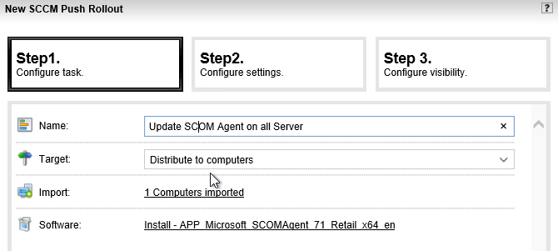
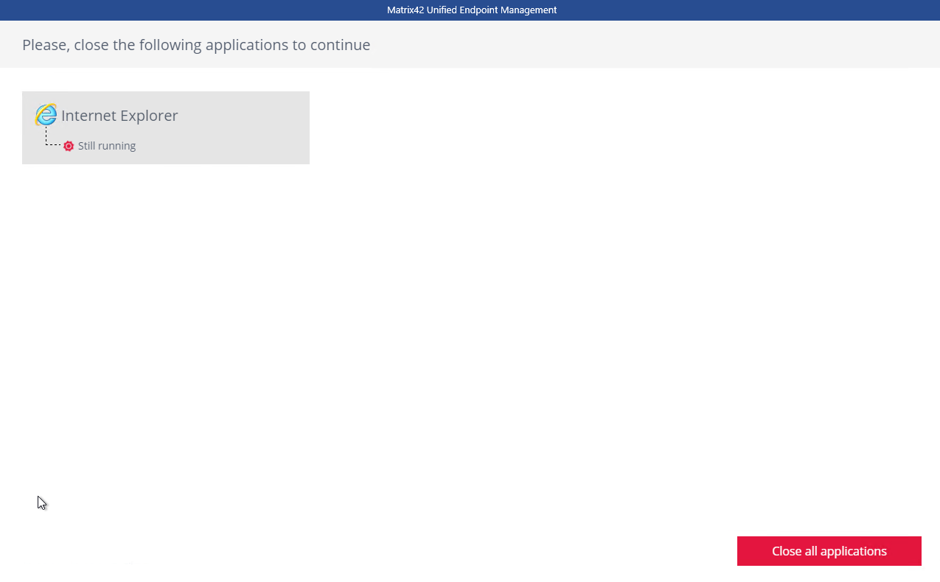
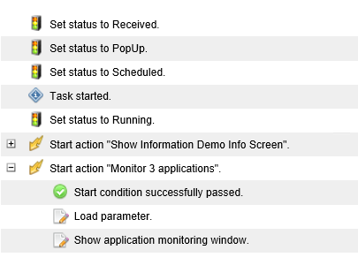
Client changes Helpdesk
How it works
Admin UI
Client UI
Admin UI
Push
Monitoring

Slide 7
Examples for cost saving On-Site IT
You employ at minimum ~1 2nd Level engineer for every location with more than 200 clients
In Munich a 2nd Level Engineer earns ~3.500€ p.m.
~ very often the role of the 2nd level engineer is outsourced
15 -> 4 minutes
25€ -> ~7€
10 -> 4 minutes
17€ -> ~7€
15 -> 4 minutes
25€ -> ~7€
100
80
60
Volume
SCCM native
40
With EM
20
Check rollout in location
Assing SW to all clients in location
Check hardware rollout

Slide 8
Examples for cost saving On-Site IT
Examples for solutions in EM
Mass rollouts to a location are very easy done by „assignment by permission of user“
A report to visualize the state of a rollout is done with a few clicks
Outsourcing without complexity
Simple inventory / reporting access
You employ at minimum ~1 2nd Level engineer for every location with more than 200 clients
In Munich a 2nd Level Engineer earns ~3.500€ p.m.
~ very often the role of the 2nd level engineer is outsourced

Slide 9
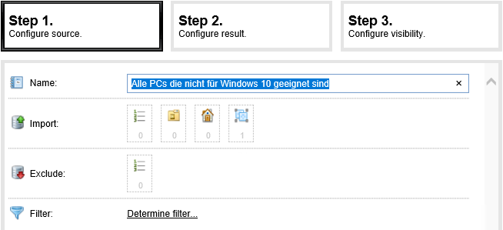
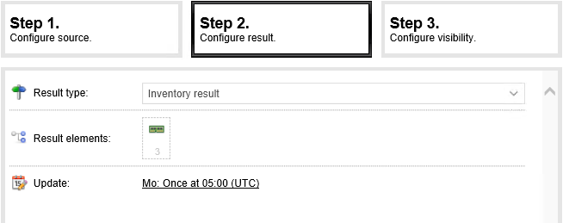
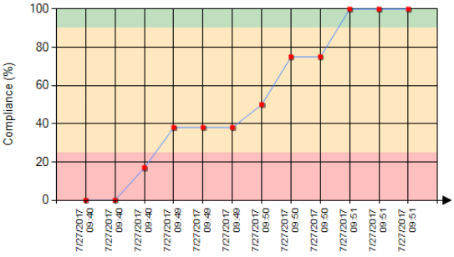
Report Erstellung (not just On-Site IT)
Simpliness is key
Select target objects
Configure result
Graphical compliance report

Slide 10
Examples for cost saving Central IT
You employ at minimum 2 Administrators for SCCM
In Munich a well trained SCCM Administrator earns ~4.400€ p.m.
„New“ worthful technologies (like App-V, UEM, …) cannot be implemented because Workplace Admins drown in daily business.
15 -> 4 minutes
25€ -> ~7€
60-> 15 minutes
100€ -> ~5€
10 -> 0 minutes
20€ -> 0€
100
80
Volume
60
SCCM native
40
With EM
20
Add something to a package
Instruct colleagues in IT tasks
IT related communication

Slide 11
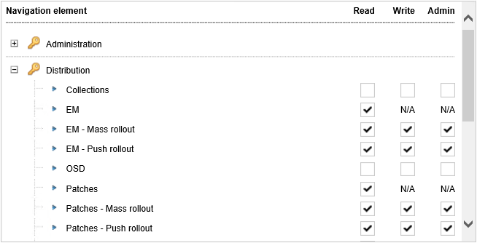
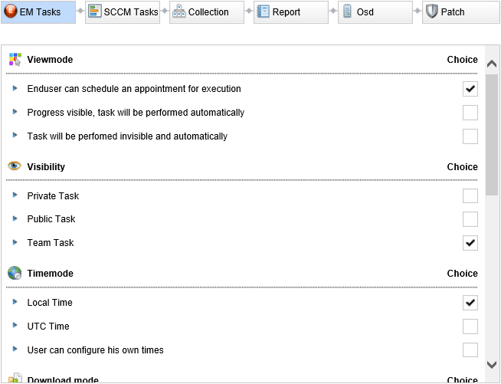
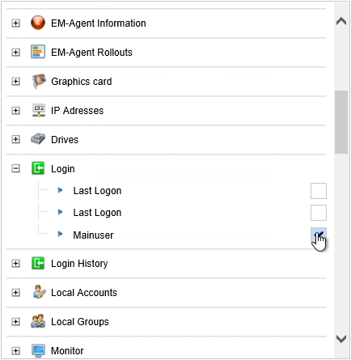
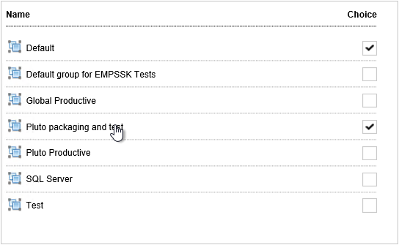
Examples for cost saving Central IT
Customize EM UI with role model
Control every single wizard
Manage inventory visibility
Do release management

Slide 12

Cost savings with EM
Cost optimization with EM can be done in 3 steps:
Make live easier for Central-, Onsite-, and Helpdesk Support
Optimize processes in your company
Reduce interruption for End-User
SCCM native
With EM

Slide 13
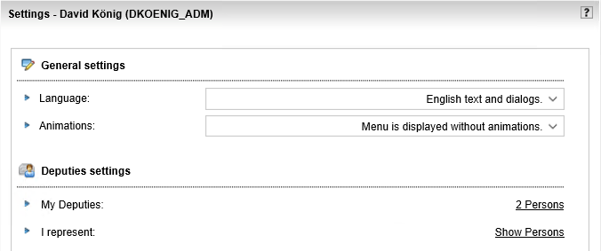
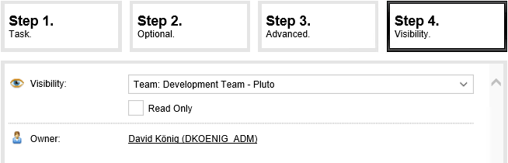
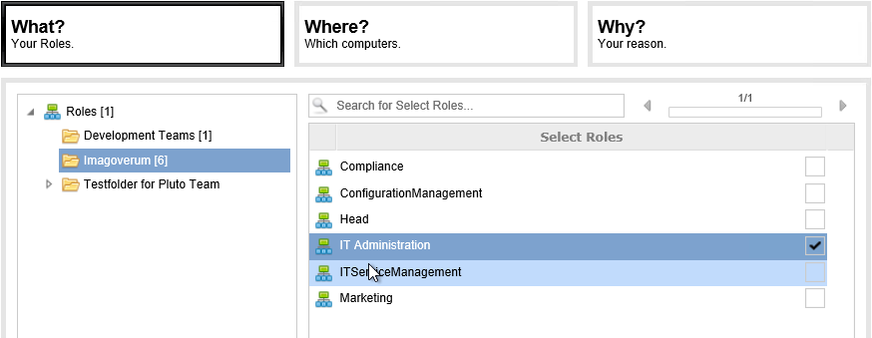
Handling „poor processes“ with EM
Who is administering SCCM, when SCCM admin is in vacation?
With EM the Administration tasks in SCCM are reduced dramatically and user-friendly available in EM Console
Who follows something up due to unplanned absence?
In EM a deputy can be defined in every users personal profile
How can i make sure, that my whole team can access something (software, task, report, client, …)?
The visibility of every task in EM can be controlled (private, public, team-based)
How can i grant a trainee some permissions in SCCM over a delimited time?
By workflow-based requests initiated by trainee

Slide 14
Cost savings with EM
Cost optimization with EM can be done in 3 steps:
Make live easier for Central-, Onsite-, and Helpdesk Support
Optimize processes in your company
Reduce interruption for End-User
SCCM native
With EM

Slide 15
Understand the problem of „User interruption“
1
Unplanned down-time due to reboots will cost at minimum the work time of the user (avg. ~1,60€ per minute).
Unplanned downtime of critical systems can raise the cost per minute into millions of €.
2
User interruption must be prohobited by the packaging engineer directly in the package
Which is complex and must be done again and again

Slide 16
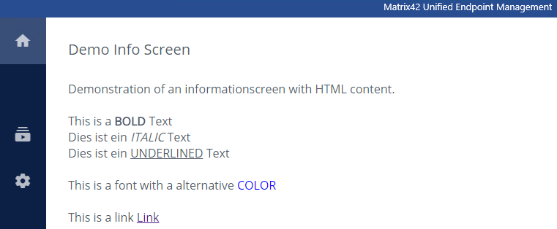
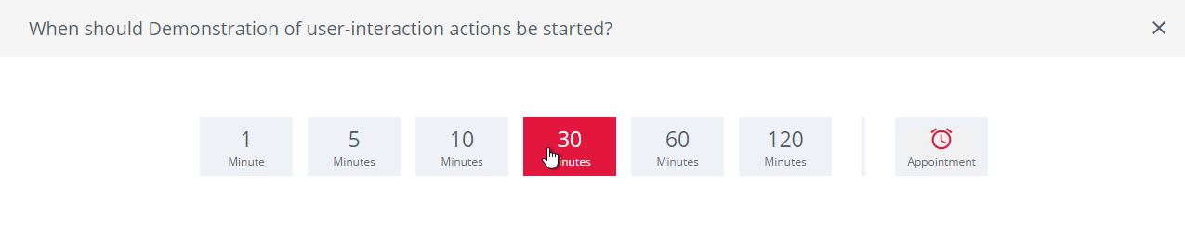
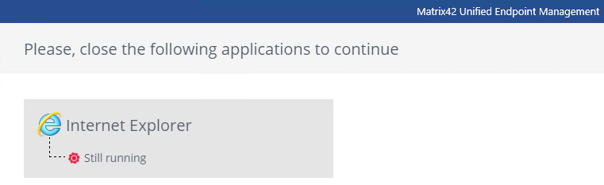
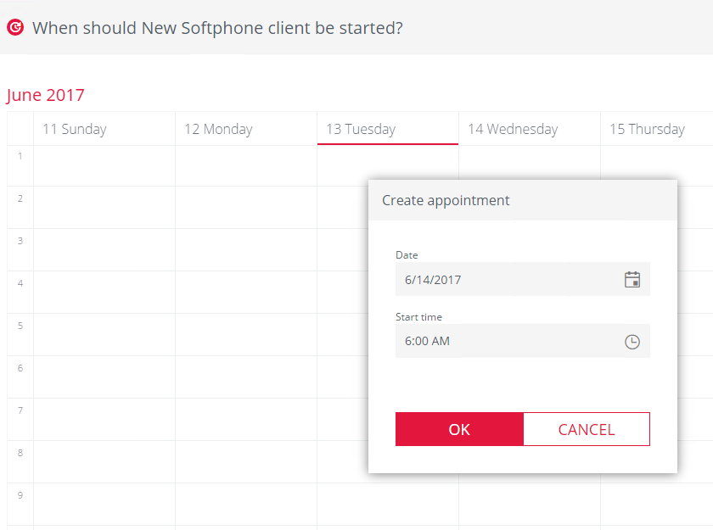
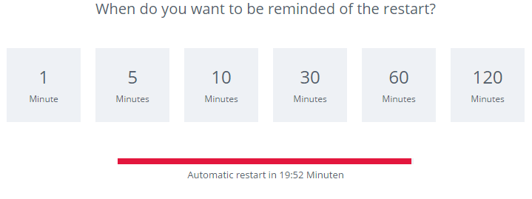
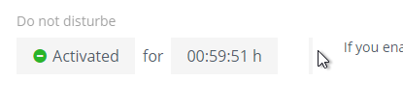
Optimized with EM-Agent
Simple text message
An administrator cannot decide when the right moment for a reboot is there.
With EM, a user is able to
…postpone installations
…schedule installations like in any other calender App
…define „do not disturb“ timeframes
…answer questions (what‘s your room number)
…get information screens about current action
…postpone /control reboots
…quit applications controlled that should be updated
of course everything in admin-defined-scopes
Move time of installation
Application Monitoring
Calender-based appointments
Reboot management
Do-not-disturb

Slide 17
Cost savings with EM
Cost optimization with EM can be done in 3 steps:
Make live easier for Central-, Onsite-, and Helpdesk Support
Optimize processes in your company
Reduce interruption for End-User
SCCM native
With EM

Slide 18
Call for „partners“
Of course, we‘d like to hear that you are interested in using Enterprise Manager
But we are searching also Consulting / Reseller companies who are interested to use EM in their projects or add EM to their „software catalog“
For a live demonstration, just ask ;-)

Slide 19















Thanks to our Sponsors!

